Slide 1
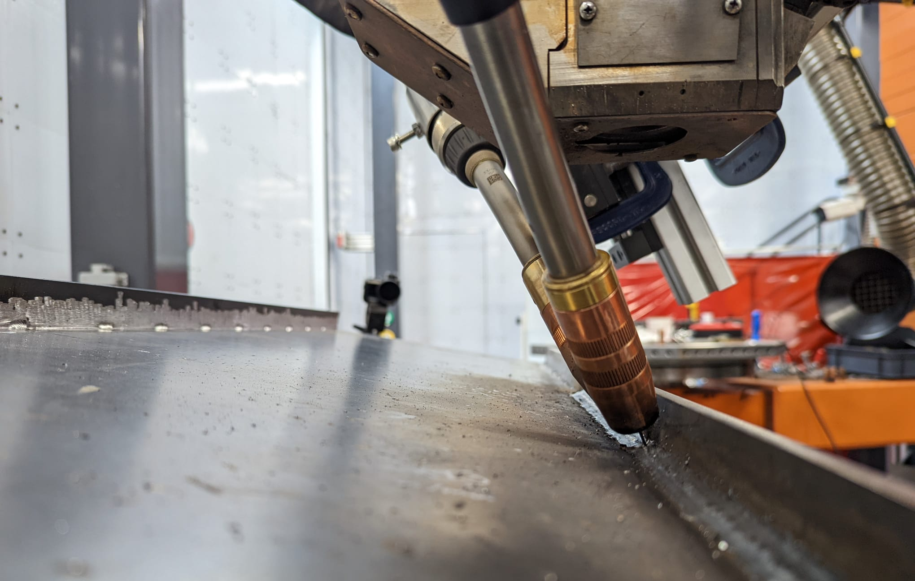
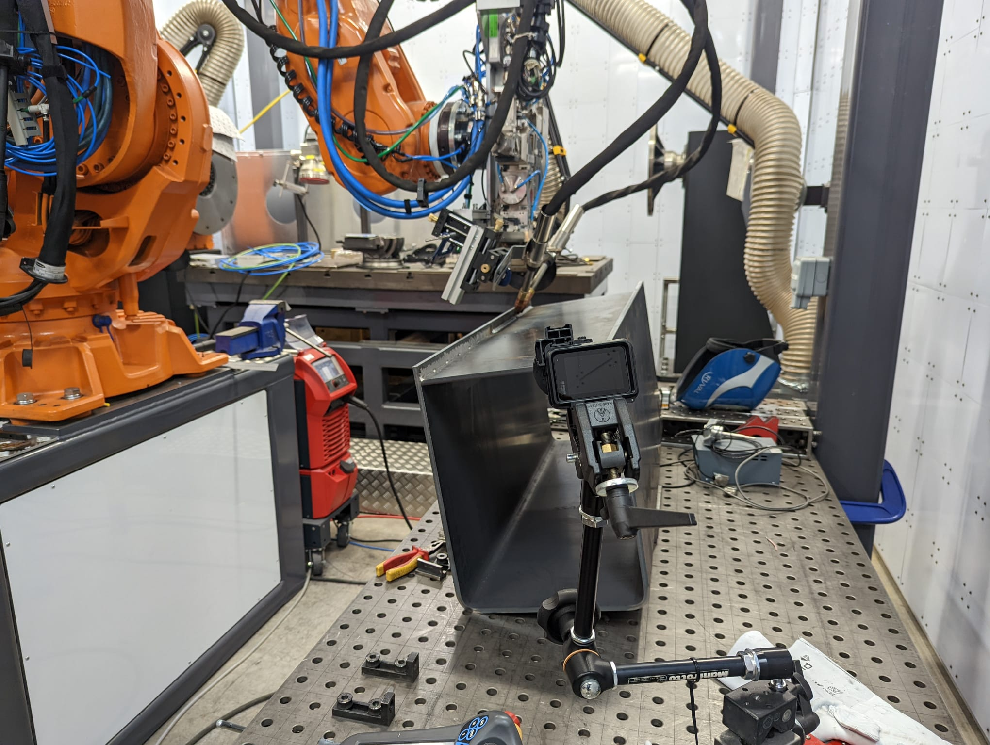
Market Sector:
Technology Theme:
BUILT ENVIRONMENT
LASER PROCESSING
DEMONSTRATING HIGH SPEED WELDING FOR LARGE PARTS
APPLICATION OF A HYBRID LASER ARC WELDING PROCESS
Insert Picture
(and supply original image file)
DEMONSTRATING HYBRID LASER ARC WELDING (HLAW)
The MTC has demonstrated an automated hybrid welding technique on a four metre part that realises the high speed and low distortion properties of laser welding whilst being able to bridge a large air gap between plates. This opens up new applications for laser welding in sectors such as construction and automotive.
Mickey Crozier, Technology Manager for CMT
THE CHALLENGE
MTC’S SOLUTION
One of MTC’s members had identified a gap in the UK market for the application of hybrid laser arc welding to replace and improve upon the current welding process for large-scale parts used in the yellow goods sector, among others.
In previous work the member developed this technique using sub-scale trials. To enable industrial uptake the member now needed to demonstrate the technique at an industrial scale. The member approached the MTC to support the development of a full scale demonstrator and to prove out the feasibility work already undertaken.
The MTC modified an existing large-scale robotic laser cell to include two gas metal arc welding (GMAW) heads, as well as building custom fixturing to allow 6-axis manipulation of the arc torches around the laser focus.
Parameter development was conducted on a fillet joint on multiple thicknesses. Trials were undertaken from bead-on-plate welds to four metre long welds.
The welds were analysed against customer specifications through the use of blue light interferometry for distortion analysis.

Slide 2
THE OUTCOME
BENEFITS TO THE CLIENT
Successful verification and development of the feasibility work previously undertaken and demonstration of scale up in an industrially relevant cell
A number of successful one metre welds as well as a successful four metre weld on 8 mm and 10 mm thick plate joints completed, all of which met the weld specifications required
Demonstrated a three fold increase in process speed, alongside increased weld penetration, decreased weld volume (hence less excess material and cost) and reduced deformation compared to the traditional twin wire GMA process
Enabled MTC member to demonstrate their hybrid process to a range of customers in the UK, with a 4 m weld able to be completed in just 4 minutes
Demonstrated benefits over traditional robotic twin wire processes which will result in cost savings for many industries which rely on this process (e.g. shipbuilding, bridges, cranes, diggers etc).
Enable UK PLC to penetrate into new markets and improve sales in these sectors which traditionally have not been accessible for laser suppliers
This process could be game-changing for many industries that currently just wouldn’t consider laser welding due to its gap limitations. The ability to work with an MTC member to demonstrate it on such large components at a facility here in the UK is a great outcome for the MTC.
Bethan Smith, Technology Manager, MTC
300%
2 mm
35 %
Faster than gas metal arc welding
of distortion across a 4-meter part
Reduction in weld volume (excess material) compared to gas metal arc welding
Insert Picture
(and supply original image file)
Manufacturing Technology Centre,
Pilot Way, Ansty Park,
Coventry, CV7 9JU
Tel: +44 (0)2476 701 600
www.the-mtc.org

