Slide 1
Hydrogen HGVs in Construction
Briefing Document
Condensed

Slide 2
Content
Introduction to MTC & HS2
Hydrogen HGVs in Construction Project Overview
Workshop Feedback

Slide 3
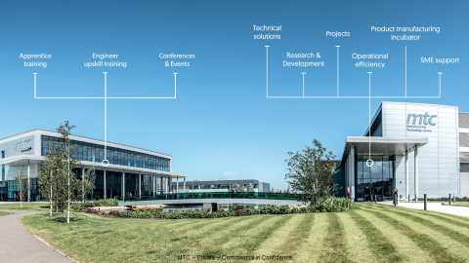



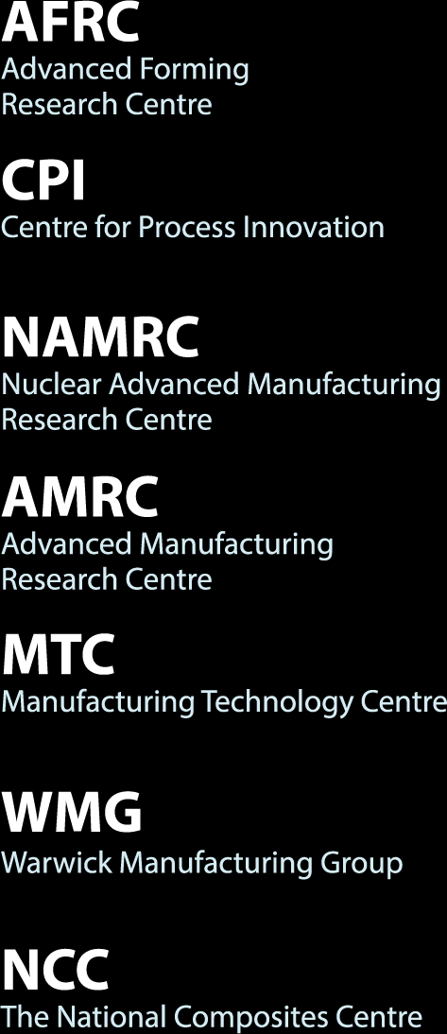

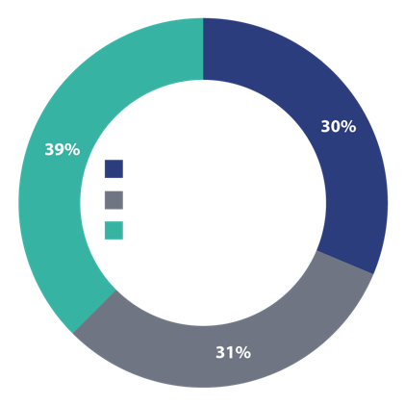





MTC hosts the Construction Innovation Hub
400+ engineers on site
Supported by 100+ Industrial member partners

Slide 4
Bringing Britain closer together
HS2 is now being built, it will form the spine of our rail system.
Key facts
    345 miles of brand new high speed track will connect Birmingham, Manchester, Leeds and London.
    HS2 trains will also run on the existing network, serving towns and cities in the North West, North East and Scotland.
    HS2 will connect 30 million people and 8 of our largest cities, with 25 stops from Scotland to the South East.
Notes:
Introduction 3: the HS2 route
HS2 will be the new high speed backbone of our rail network connecting the city centres of Birmingham, Manchester, Leeds and London.
Once fully completed, we will have built 345 miles of new high speed track (equivalent to over half the length of Britain Lands End to John O’Groats as the crow flies). The new line will include intermediate stops at Old Oak Common in West London, Birmingham and Manchester Airports, Crewe and at Toton in the East Midlands between Derby and Nottingham. HS2 will also be integrated into the East and West Coast Main Lines, so HS2 trains will cross over to the existing network and serve towns and cities in the North of England and Scotland. HS2 trains will stop at over 25 stations.
This will open up access to the high speed network to around half the population of Britain and cut journey times between the North and the South. When fully operational, up to 48 HS2 trains with up to 1,100 seats each will be running every hour on the UK’s rail network. This is a huge undertaking; Britain’s first new intercity railway north of London in 100 years; Europe’s largest infrastructure project.

Slide 5
Phase One
216
KM ROUTE LENGTH
75
KM OF CUTTINGS
63
KM OF EMBANKMENT
16
KM OF VIADUCTS
1.3m
TONNES OF STEEL
300
CONSTRUCTION COMPOUNDS
13m
TONNES OF CONCRETE
63m
m³ EXCAVATED MATERIAL

Slide 6
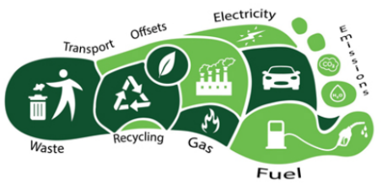
What’s the Challenge?
The UK government committed to bring all greenhouse gas emissions to net zero by 2050. HS2 expected by government and stakeholders to be part of the solution.
HS2 Legal obligation (Phase One Act): to limit the carbon footprint to that reported in the Environmental Statement
HS2 Strategic Objective to ‘design, build and operate HS2 to reduce carbon’
HS2 Environmental Policy: Sets objectives against Climate Change and Being a good neighbour
Commitments:
HS2 Corporate KPIs on Carbon reduction
MWCC, station and rail system contractors are required to achieve 50% carbon reduction
HS2 Air Quality Emission Requirements and Targets

Slide 7

















What’s HS2’s Solution?
There are no “One-Size-Fits-All” solutions
We are innovating and collaborating across industry, academia and the supply chain.
Energy Infrastructure
Construction
Build understanding and develop evidence
Influence policy to stimulate demand & supply
Address challenges and common issues with multiple stakeholders
Develop market guidance and share best practice

Slide 8
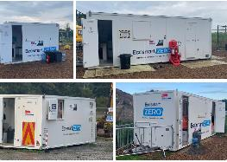
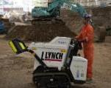

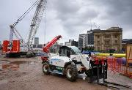
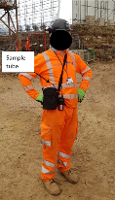
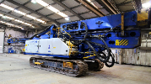
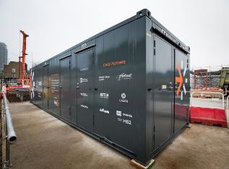
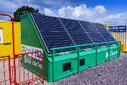
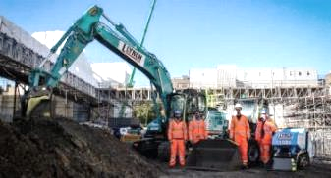
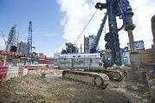
Innovations / Opportunities
Deployment of low/zero emission alternatives
Continued deployment low and zero emission equipment across our sites
Including fully electric, solar and hydrogen technology and hybrid plant (welfare units, excavators, telehandlers, tower lights, crawler cranes)
NRMM Emission Reduction Innovation
Working with CSJV, BBV, BBVS and Imperial College London, to:
Better understand plant emissions on-site
Site worker exposure
Develop NRMM management Plan (to reduce exposure)
Development of low emission technologies
Clean Air Gas Engine
Innovate UK funded project – led by OakTec.
Trialling replacing diesel power equipment with ultra low (bio-LPG) emission engines
Deployed at St. James’ Gardens (near Euston Station) – trial to be extended across route
Exhaust emissions monitored by Imperial College London
Developing a larger version of the same technology
Zero Carbon cabins / Solar Pods
Trialled Eco-smart Zero’s zero carbon cabins on some of our sites
Reducing emissions from plant across construction works
Reducing NRMM emissions & exposure – development of retrofit opportunities
Hybrid system – renewable & bio-LPG reducing emissions
Reducing emissions / exposure to pollutants

Slide 9

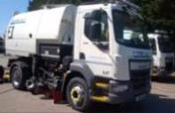



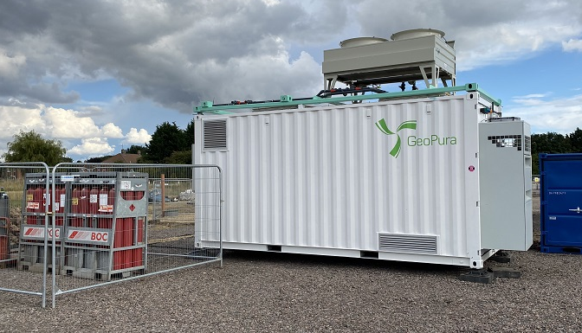

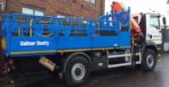


Hydrogen Innovation
Current Projects
Hydrogen Dual-Fuel System in Heavy Goods Vehicles
Aimed at demonstrating the technology in construction activities
Trial of 3 HGVs fitted with the dual fuelling system. Emission testing to quantify the savings
Up to 35% GHG savings with green hydrogen
Hydrogen Fuel-Cell Generators
Hydrogen Fuel-Cell technology (at scale)
Off-grid power system alternative to diesel generators, hydrogen fuel-cells charge batteries and supply glitch free critical, always live power via UPS
Strategic Business Case for Hydrogen in Construction
Working with the Manufacturing Technology Centre on gathering insight and Building a Strategic Business Case
Aimed at highlighting full scale opportunity, cost benefit analysis and timescales around the use of hydrogen in construction vehicles (HGVs)
Notes:
Early trials of hydrogen/electric van in 2017/2018
Small hydrogen generators to power smaller equipment (noise and air quality monitors)
Hydrogen fuel-cell powered site flood lighting / welfare units
Key current hydrogen focused innovation projects:
Dual Fuel: Considering the introduction of stricter emission requirements, hydrogen retrofits can help us extend the life of existing vehicles.
Both avoiding the financial and embedded carbon costs associated with buying new.
In this project we will be trailing retro fit technologies across several on-road construction vehicles.
This trial will demonstrate how well this technology works out in the field. Using a duel fuel system, converted vehicles emit significantly less emissions. As we seek cleaner methods of generating hydrogen, the carbon footprint of these vehicles will also reduce. When generated from renewable energy sources hydrogen is a zero-carbon fuel.

Slide 10
Challenges in Construction
Hydrogen & Electric
Diesel
Efficiency Solutions
Hydrogen
Electric
Hybrid Solutions
Sparse network of hydrogen refuelling infrastructure
Normalising onsite hydrogen power generation as opposed to diesel
    Limited supply and range of suitable hydrogen equipment
    Limited understanding/confidence in new technology (reliability / de-myth (misconceptions of hydrogen – H&S)
    On-site space / storage limitations
    Limited supporting H2 fuel infrastructure / suppliers
Sustainability of H2 supply (Green, Blue, Grey) – avoid shifting impacts
Lack of hydrogen and battery powered construction machinery on the market (or hybrids thereof) – variety & order lead time
Medium sized hydrogen generators to compete with petrol/ diesel equivalents for remote applications
Limited battery capability / understanding for renewable power alternatives
Cost (procurement / commercials / legal) – economies of scale (supply & demand)
Reluctance to be the first mover (developing evidence through trials)

Slide 11
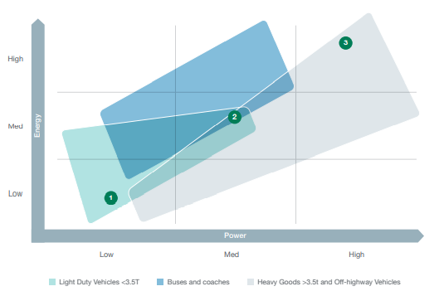
Challenges in construction
Fuel Choice
HGVs and other off-road vehicles have a duty cycle of 4-5k hours per year, so any alternative fuel /power source needs to be able to meet this demand
Changing HGVs from diesel to an alternative fuels will be limited by additional weight, power and energy requirements
  One alternative, the weight of the battery makes it prohibitive for HGVs
There are a few potential routes for hydrogen power, for example hydrogen Fuel-Cells, Dual-Fuel, hydrogen ICE engine
  Scaled cost of Fuel-Cell is a limitation, alongside, weight, sensitivity to vibration, dirty atmospheric environments, and the very high purity of hydrogen required
As an example, JCB explain their reasoning for the production of ICE-type engine powered by hydrogen in a video by Harry’s Farm
  Why JCB thinks hydrogen is the best alternative to diesel for heavy machinery, farming and HGV fleet - YouTube
Automotive Council 2020 roadmap showing the power and energy requirements for different Goods vehicles and Off-highway equipment. Taken from “Heavy Goods >3.5t and Off-highway Vehicle Roadmap 2020”, APC, Feb 2021
Notes:
E.g. a 22tn truck would need a 6tn battery, changing the total weight to 28tn.

Slide 12
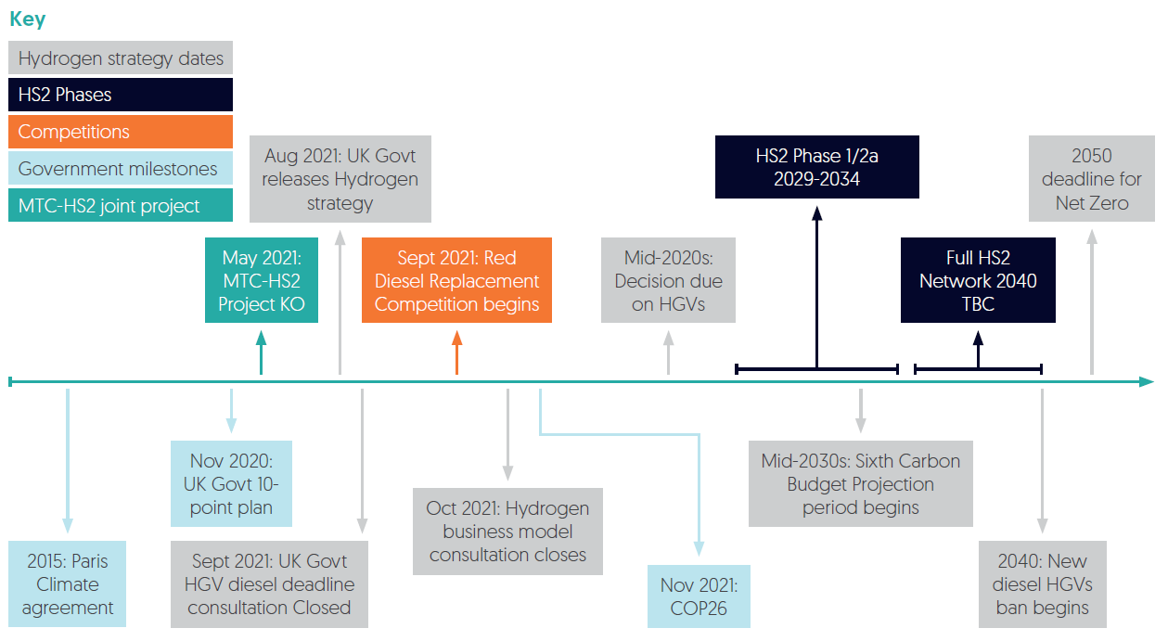
Hydrogen timeline
Timeline from H2 strategy

Slide 13
Overview
Hydrogen in Construction
What:
  Proposed use of hydrogen to power HGVs, through either Dual-Fuel (hydrogen & diesel), hydrogen Fuel-Cell or direct hydrogen fuel
How:
  Bringing together a community to tackle the barriers
  Hosted interviews: discussion with those from cross the supply chain on the risks, benefits and support requirements for a transition to hydrogen powered HGVs
This gathering of the supply chain community aims to:
  Identify and address barriers to hydrogen technology development and adoption within the construction industry
  Lay the foundation for the establishment of a collaborative workgroup to tackle the identified barriers
  16 organisations have contributed so far

Slide 14
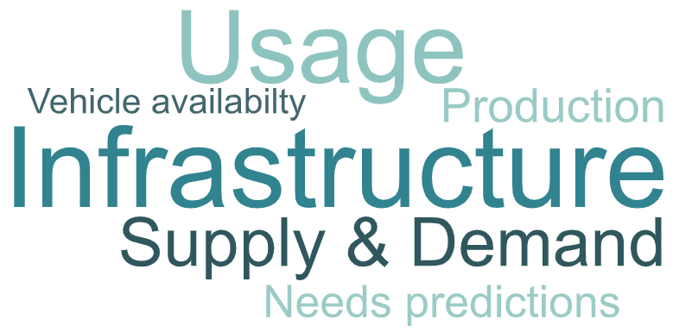



Industrial Engagement
Stakeholder Engagement Feedback

Slide 15
Hydrogen HGVs in Construction
Action Log
# | Action | Progress
1 | Map out the construction programs of big projects as use cases for demand, over the next 10-15yrs. Would allow for the development of: Localised supply chains Technical colleges employ H2 apprentices etc | On-going
2 | Overcome first mover disadvantage. Prove advantages for someone to buy H2 now, rather than waiting for a more efficient electrolyser | Support wanted
3 | Develop revenue-support business model to address policy gap between RTFO and hydrogen business model | Support wanted
4 | Study/info pack for dissemination on link between MW of electrolyser to H2 production compared to diesel E.g. X MW is Y tonnes of hydrogen, which could power Z construction vehicles at a single site | Support wanted
5 | National Hub round table – 6 month regular Lesson learnt sharing - Aberdeen, Tees Valley Hub | On-going

Slide 16
Thank you
For further information please see the webpage for details:
(Hydrogen HGVS In Construction (the-mtc.org))

